Slide 1
Respiratory Acidosis and Dialysis

Slide 2
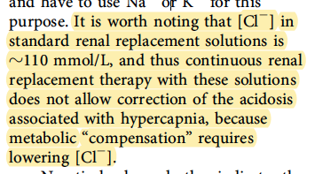
DOI: 10.1513/AnnalsATS.201409-426OI

